Slide 1

A Wearable, Multimodal Sensing System to Monitor Knee Joint Health^{[1]}
Group: F3
Yuhan Wu, Yanze Liu, Yongjiang Chen
Dec 12th , 2023

Slide 2
Introduction -- Background and Objective
The current wearable medical technology represents a popular research area.
In orthopedics, “Joint Health Assessment” is particularly important.
Only in laboratories/clinical medicine are there specific instruments used to measure “Knee Joint Health Data”.
Exploring the design of wearable multi-sensor modes for assessing knee joint health.
2
Notes:
目前可穿戴医疗技术代表着一个热门的研究领域
骨科学中的“关节健康评估”尤为重要
只有实验室/临床医学中才有特定仪器测定“膝关节健康数据”
探索设计用于评估膝关节健康的可穿戴多传感模式

Slide 3
Introduction -- Specific Functions of the Device
Microphones: Measuring joint sounds to differentiate between healthy individuals and patients with arthritis, to classify different conditions.
Electrical Bioimpedance Circuitry(EBI): Detecting real-time joint resistance indices to assess swelling.
Wearable Multimodal Smart Brace
Inertial Measurement Units(IMUs): Providing information on joint stability and range of motion.
Temperature Sensor: Monitoring local skin temperature.

Slide 4
Embedded Systems Design -- System Structure
Audio Board:
Microphones
Electrical Bioimpedance Circuitry(EBI)
All data is written to the ‘microSD’ card.
Embedded Systems
Main Board:
Inertial Measurement Units(IMUs)
Temperature Sensor
3D Flexible Bracket

Slide 5
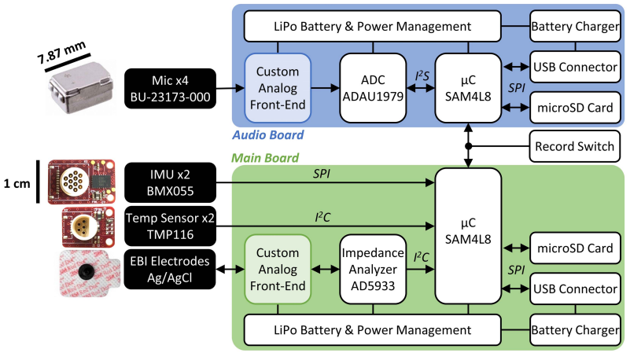
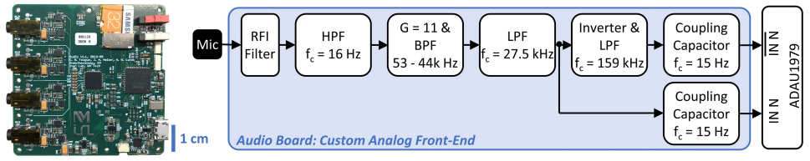
Embedded Systems Design -- Audio Board Design
The protocol supports the consolidation of four audio channels into one channel
Sampled differential signal
Bandwidth accelerometer
High gain bandwidth product and low noise
The signal is low-pass filtered by the second-order Sallen-Key.
Inverter, used to create a differential signal.
Notes:
接触式麦克风实质上是一种宽带加速度计，它可以检测皮肤对关节底层声学发射的振动响应。

Slide 6
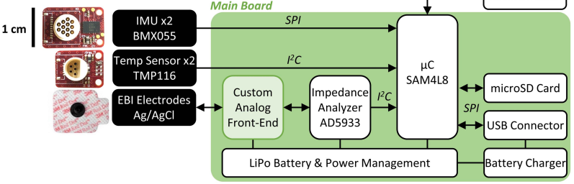
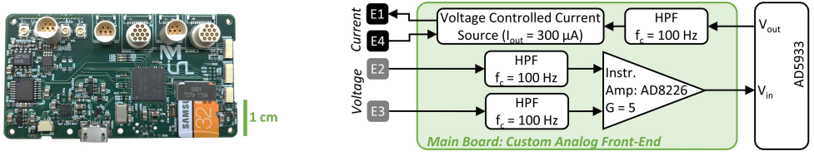
Embedded Systems Design -- Main Board Design
Three-axis accelerometer, gyroscope and magnetometer
Use four-electrode configuration
Notes:
采用了四电极配置，外部电极（E1 和 E4）通过组织提供电流，而由内部电极（E2 和 E3）连接的高阻抗仪器放大器（IA））测量电压。

Slide 7
Design and
Proof-of-concept Results -- Brace Design
Circuit Box: Containing the main and audio PCBs, two batteries and switches for initiating and stopping recordings.
Two sensor housings: Containing IMU, temperature sensors and two electrode snaps for EBI measurements.
Brace Design
Microphone standoff: Route the cables away from the leg and provide sufficient slack throughout the entire range of motion.
Notes:
采用了四电极配置，外部电极（E1 和 E4）通过组织提供电流，而由内部电极（E2 和 E3）连接的高阻抗仪器放大器（IA））测量电压。

Slide 8
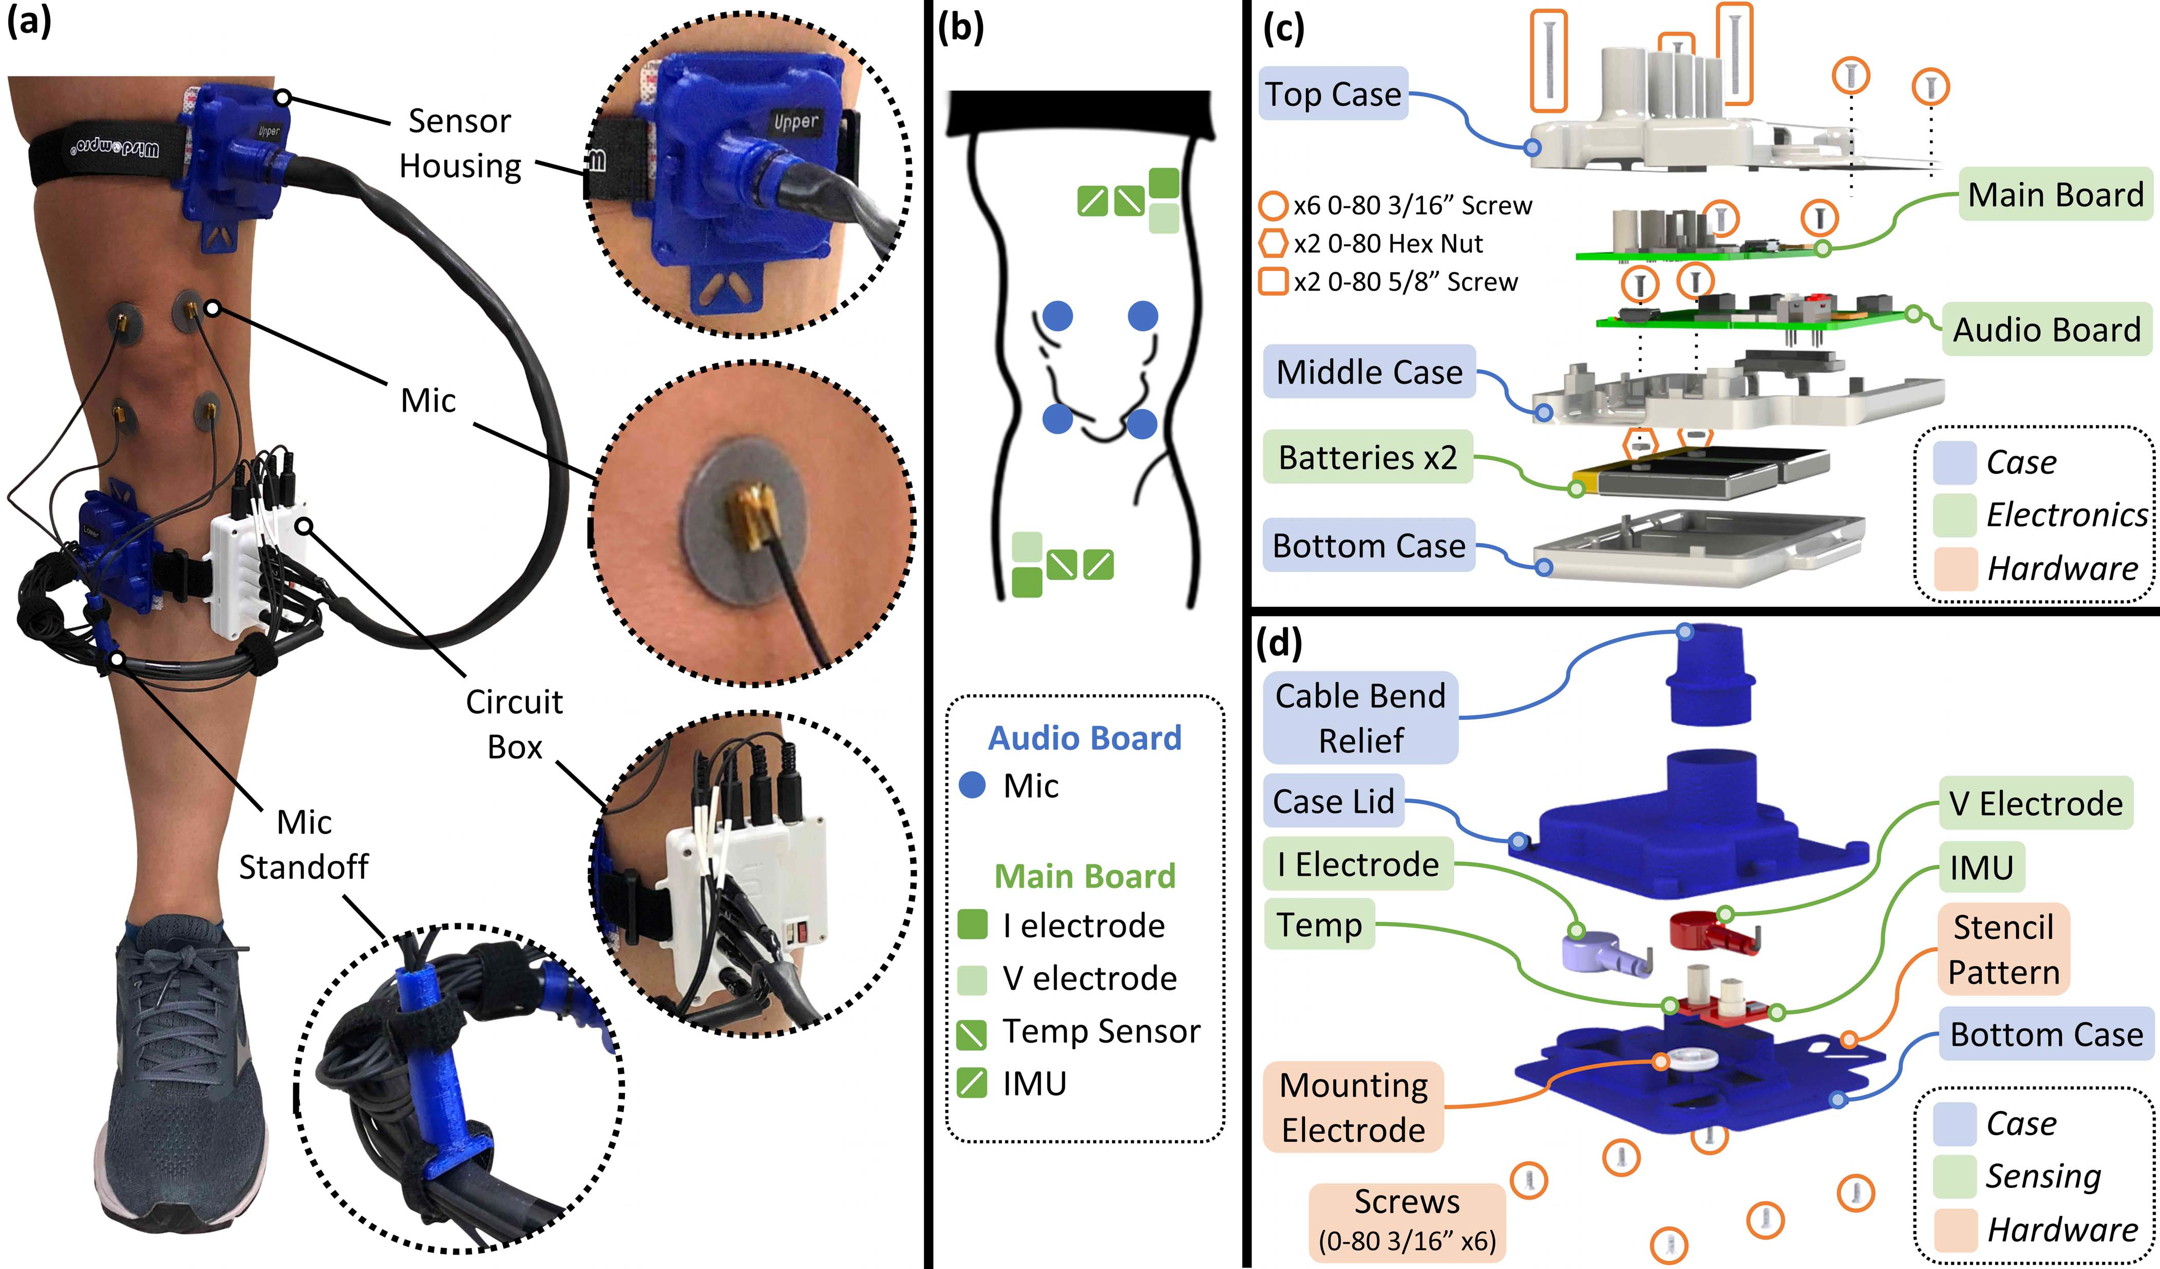
Design and
Proof-of-concept Results -- Brace Design
Notes:
采用了四电极配置，外部电极（E1 和 E4）通过组织提供电流，而由内部电极（E2 和 E3）连接的高阻抗仪器放大器（IA））测量电压。

Slide 9
Design and
Proof-of-concept Results -- Affixing the Brace
Why the affixing of the brace is important?
Ensure the sensors acquire the desired data at specified anatomical locations.
Facilitate valid longitudinal data comparisons.
For joint acoustics: The positioning of the microphones with respect to the joint may influence the type of sounds measured.
For EBI: EBI electrode spacing must be maintained to capture the same segment of the limb.
Notes:
采用了四电极配置，外部电极（E1 和 E4）通过组织提供电流，而由内部电极（E2 和 E3）连接的高阻抗仪器放大器（IA））测量电压。

Slide 10
Design and
Proof-of-concept Results -- Affixing the Brace
To enable correct and consistent placement of the brace on different person, a “stencil” approach was designed and developed. The stencil is a flexible, 3D-printed piece that provides areas to mark the subject’s skin with the appropriate mounting locations.
Notes:
采用了四电极配置，外部电极（E1 和 E4）通过组织提供电流，而由内部电极（E2 和 E3）连接的高阻抗仪器放大器（IA））测量电压。

Slide 11
Design and
Proof-of-concept Results -- Results of measurement
The signals from a single healthy man was measured. For the joint sound measurement, the subject completed 10 cycles of unloaded, seated flexion/ extension exercises.
The EBI measurement was conducted with the leg in a relaxed, seated position with fully extended and supported for 10 AC sweeps ranging from 5kHz to 100kHz.
Notes:
采用了四电极配置，外部电极（E1 和 E4）通过组织提供电流，而由内部电极（E2 和 E3）连接的高阻抗仪器放大器（IA））测量电压。

Slide 12
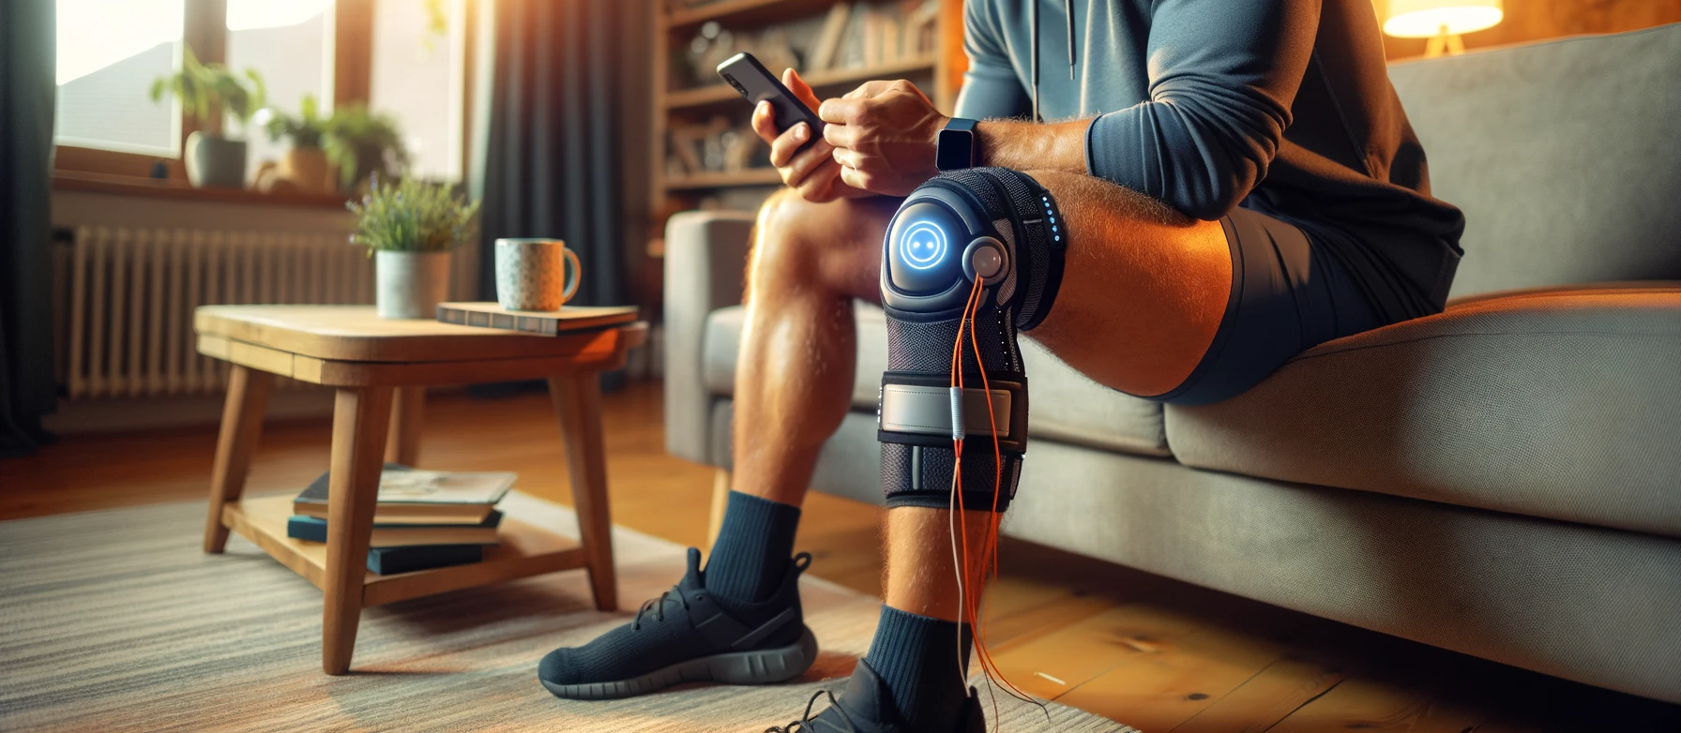
Conclusion -- The Proposed Knee Joint Health Monitoring System
John Chen
Notes:
采用了四电极配置，外部电极（E1 和 E4）通过组织提供电流，而由内部电极（E2 和 E3）连接的高阻抗仪器放大器（IA））测量电压。

Slide 13
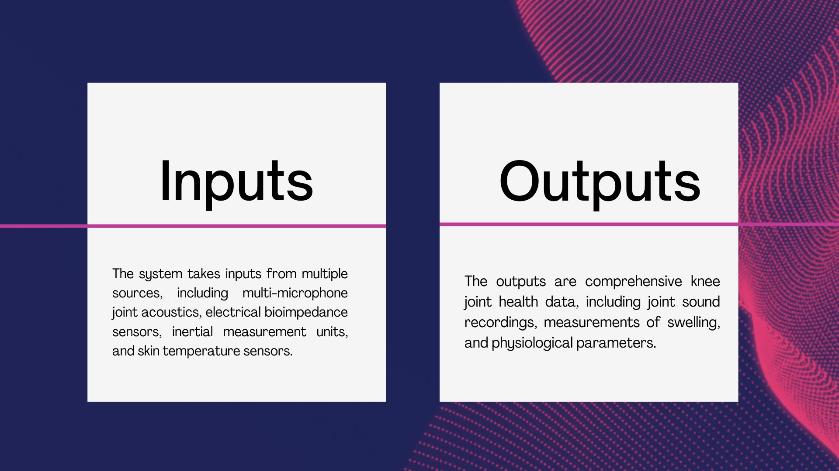
[2]
John Chen
Notes:
采用了四电极配置，外部电极（E1 和 E4）通过组织提供电流，而由内部电极（E2 和 E3）连接的高阻抗仪器放大器（IA））测量电压。

Slide 14
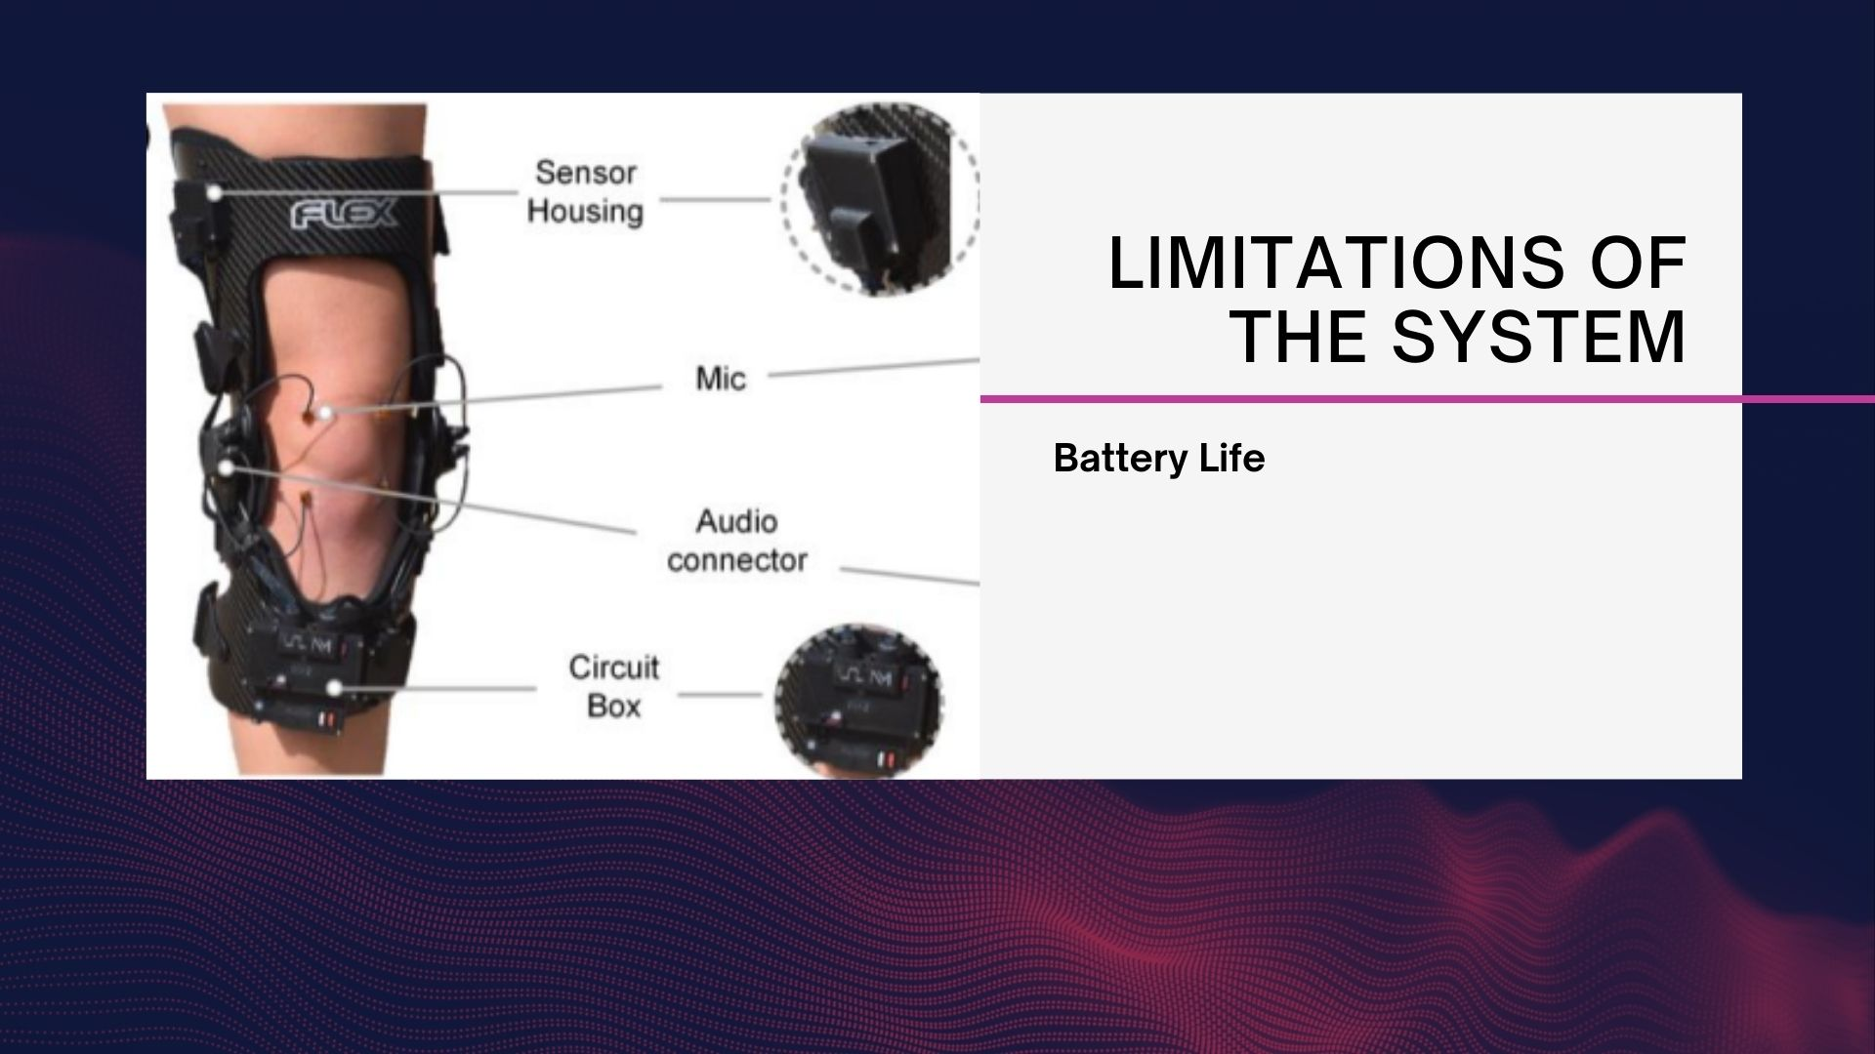
Currently, it is limited by the average current draw of the IMUs used in this design, specifically the gyroscope of the unit, which draws nearly 5 mA continuously because this sensor cannot be put to sleep at the 100 Hz sample rate given its long wakeup time.
John Chen
Notes:
采用了四电极配置，外部电极（E1 和 E4）通过组织提供电流，而由内部电极（E2 和 E3）连接的高阻抗仪器放大器（IA））测量电压。

Slide 15
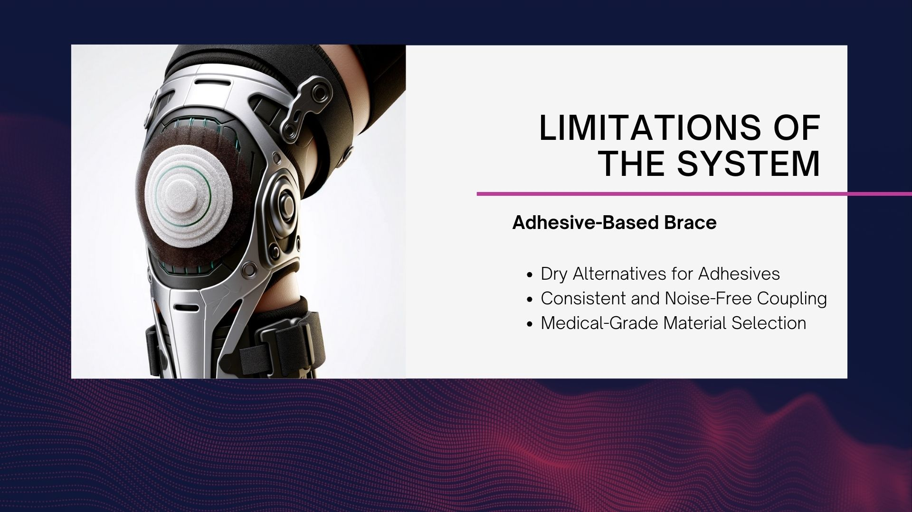
John Chen
Notes:
采用了四电极配置，外部电极（E1 和 E4）通过组织提供电流，而由内部电极（E2 和 E3）连接的高阻抗仪器放大器（IA））测量电压。

Slide 16

John Chen
Notes:
采用了四电极配置，外部电极（E1 和 E4）通过组织提供电流，而由内部电极（E2 和 E3）连接的高阻抗仪器放大器（IA））测量电压。

Slide 17
Reference
Teague, C. N., Heller, J. A., Nevius, B. N., Carek, A. M., Mabrouk, S., Garcia-Vicente, F., Inan, O. T., & Etemadi, M. (2020). A wearable multimodal sensing system to monitor knee joint health. IEEE Sensors Journal, 20(18), 10323-10333. https://doi.org/10.1109/JSEN.2020.2994552
Ozmen, G. C., Nevius, B. N., Nichols, C. J., Mabrouk, S., Teague, C. N., & Inan, O. T. (2021). An Integrated Multimodal Knee Brace Enabling Mid-Activity Tracking for Joint Health Assessment. In 2021 43rd Annual International Conference of the IEEE Engineering in Medicine &amp; Biology Society (EMBC). 2021 43rd Annual International Conference of the IEEE Engineering in Medicine & Biology Society (EMBC). IEEE. https://doi.org/10.1109/embc46164.2021.9630526
Ismail, A. H., Schlieper, G., Walter, M., Floege, J., & Leonhardt, S. (2019). Knee-to-knee bioimpedance measurements to monitor changes in extracellular fluid in haemodynamic-unstable patients during dialysis. In Journal of Electrical Bioimpedance (Vol. 10, Issue 1, pp. 55–62). Walter de Gruyter GmbH. https://doi.org/10.2478/joeb-2019-0008
DALL-E For real-life use case illustration generation. ChatGPT (openai.com)

